Slide 1
HIGH OR LOW?
RENT IN NYC
By Jone Cho

Slide 2


Slide 3
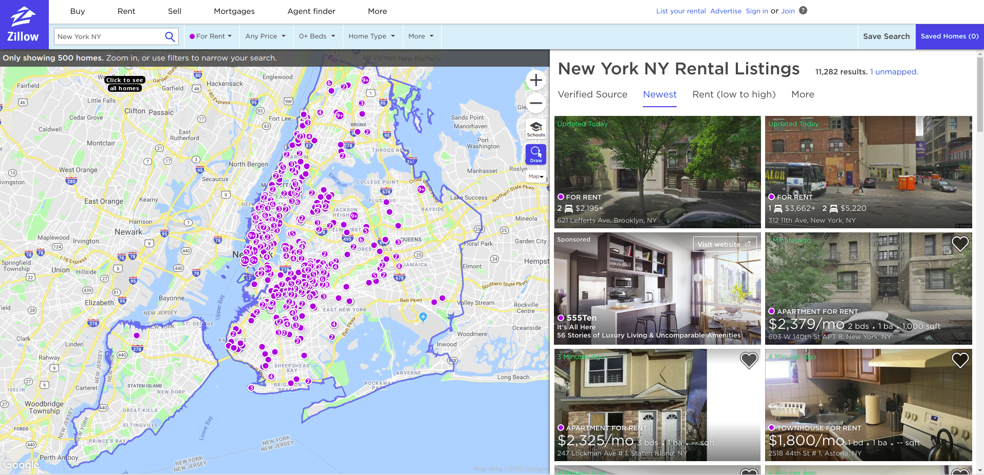
Methodology

Slide 4
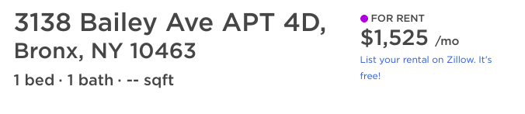
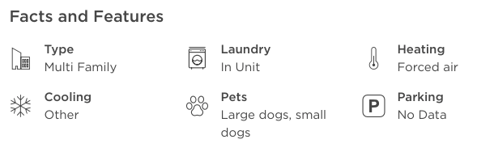
Methodology

Slide 5
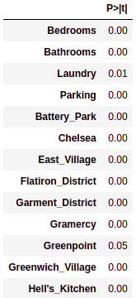
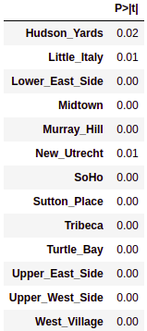
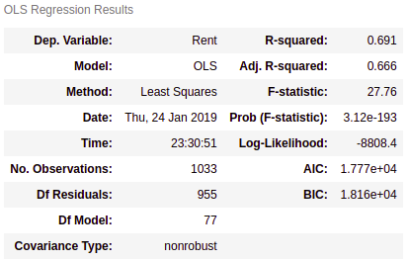
Results - OLS

Slide 6
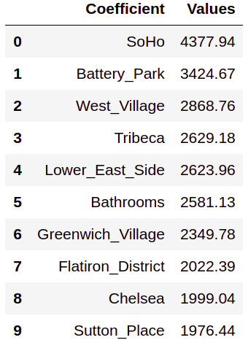
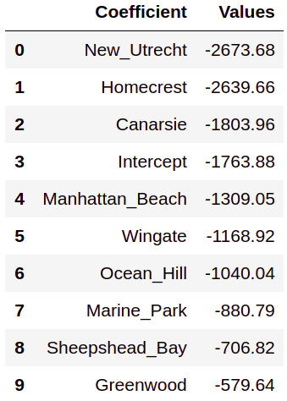
Ridge CV - Features
Top 10 Features
Bottom 10 Features

Slide 7
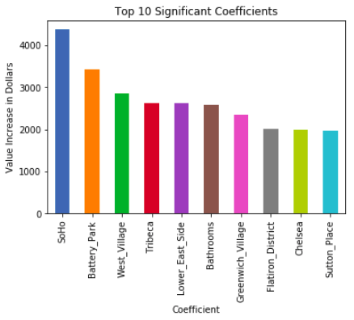
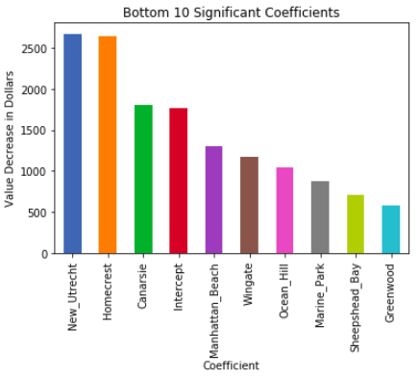
Significant Features

Slide 8
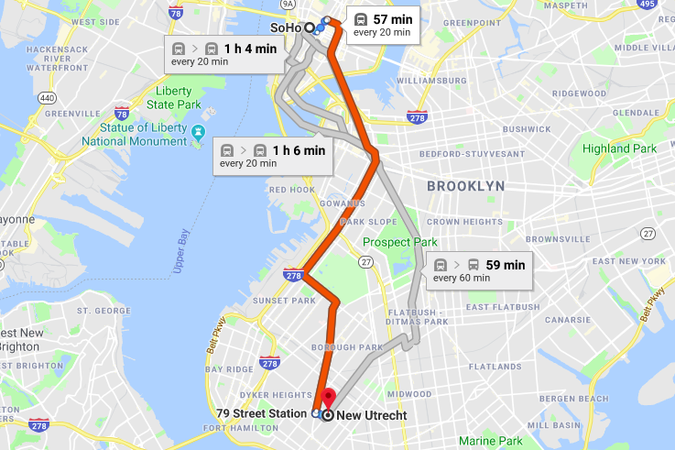
Distance between Soho and New Utrecht

Slide 9
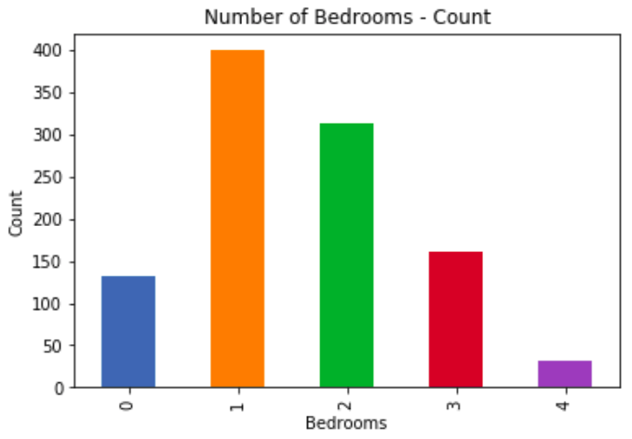
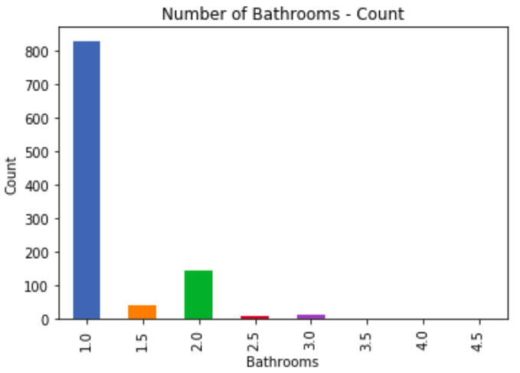
Bedroom vs Bathrooms

Slide 10
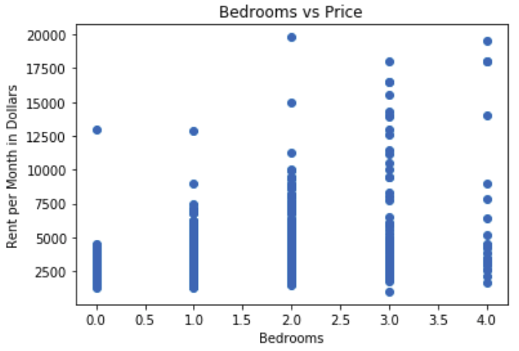
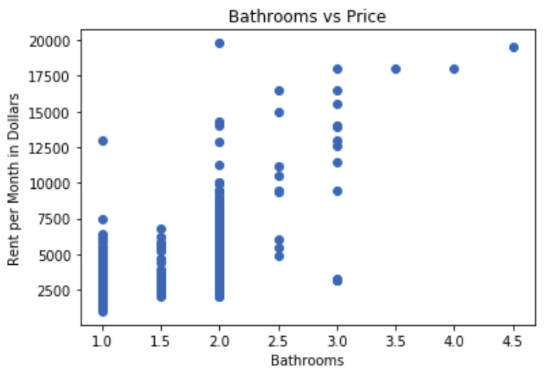
Bedroom vs Bathrooms

Slide 11
What does the outlier look like?

Slide 12
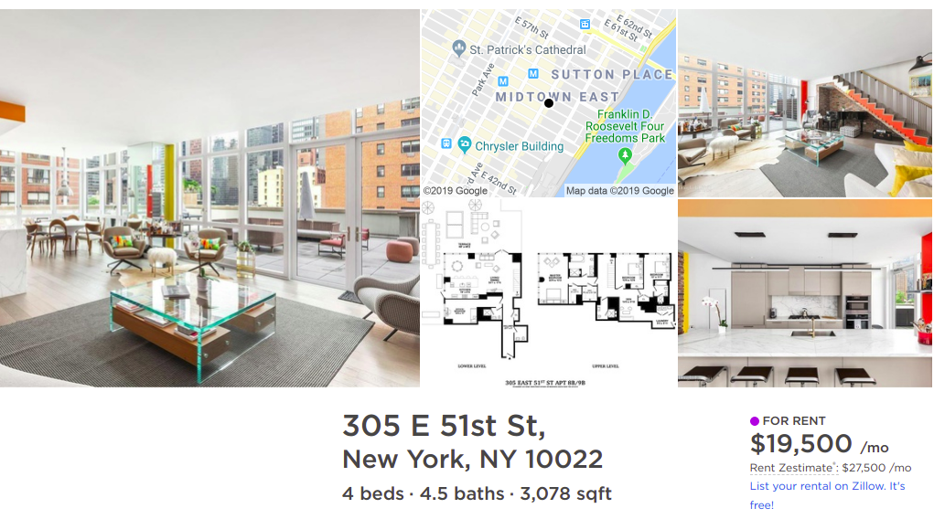

Slide 13
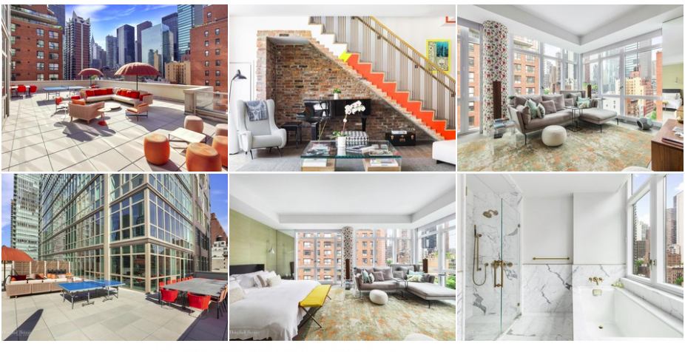

Slide 14

Conclusion
Neighborhood influences rental price the most
Greater popularity, greater demand
Followed by neighborhood is bathrooms
a unit increase of one bathroom represents a substantial change in the quality of the apartment
Next Steps:
Obtain more data
Get more detail/features
Identify trends amongst apartments
(i.e. the difference between luxury and non-luxury homes)

Slide 15
THE END

